Slide 1
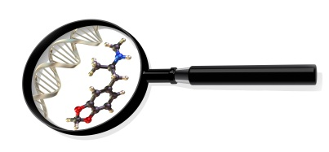

Maximizing the Amount of DNA Recovered: A Study of Mawi DNA Technologies’ iSWABTM-ID Collection Device for Forensic Science Application
Boston University School of Medicine
Program in Biomedical Forensic Sciences
72 E. Concord Street, Boston, MA 02118
Presentation By:
Michelle K. Gordon, M.S.
Notes:
1

Slide 2

Problem Statement
Recovery of DNA is extremely important
Ability to maximize collection of DNA is limited by various issues
  Structural design of swabs
  Field conditions and dry times
  Extraction procedures (>50% loss, Adamowicz et al. 2014[1])
Ability to stabilize and protect the collected DNA at the point of collection, transit and storage
[1] Adamowicz, M. S. et al (2014). PLoS ONE 9(12), 1–18.
Notes:
2

Slide 3
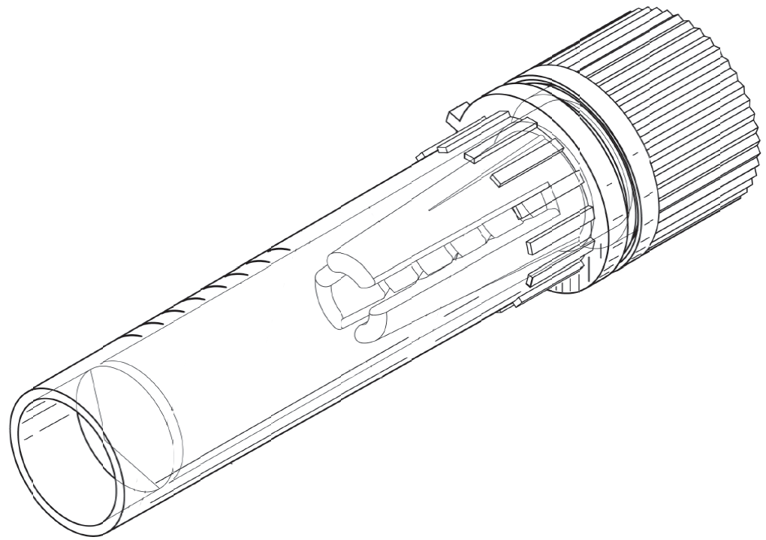
Mawi DNA Technologies’ iSWABTM-ID Collection Device
Collection device design facilitates release of cells captured from any type of swab
  Prong System
Proprietary lysis and DNA stabilizing buffer
  Used at room temperature
Kindly Provided by
Dr. Bassam El-Fahmawi,
MAWI DNA Technologies[2]
[2] US Patent No. 9,138,205
Notes:
3

Slide 4
Goal/Objectives of the Research
The purpose of the project was to define conditions and limitations of the use of the new collection device and associated (iSWABTM) buffer system for forensic samples and subsequent DNA testing
Notes:
4

Slide 5
Experiments were designed to assess the ability…
to collect dried body fluid stains
to recover and lyse cells from different types and conditions of swabs
to stabilize DNA
to perform in downstream PCR amplification
to produce quality STR profiles
Notes:
5

Slide 6
Methods
Body fluids were donated anonymously
A Hemocytometer was used to estimate concentrations of cellular suspensions
Quantifiler® Duo Quantification Kit on the 7500 Real-Time PCR system
AmpFlSTR® Identifiler® Plus Kit and the Globalfiler® Kit using the GeneAmp® PCR System 9700
3130 Genetic Analyzer
GeneMapper® ID-X
JMP ® Pro v. 13 or Microsoft® Excel for Statistics
Notes:
6

Slide 7
Optimized Dilution for Direct PCR
iSWABTM buffer Concentration | Result
0X | Not Inhibited
0.1X | Not Inhibited
0.2X | Not Inhibited
0.25X | Partially Inhibited
0.3X | Inhibited
Notes:
7

Slide 8
Protocol Based On Buffer Concentration Optimization
All experimental samples diluted to a 0.1X concentration of iSWABTM buffer prior to PCR amplification
  data confidence
  ease of calculations
Notes:
8

Slide 9
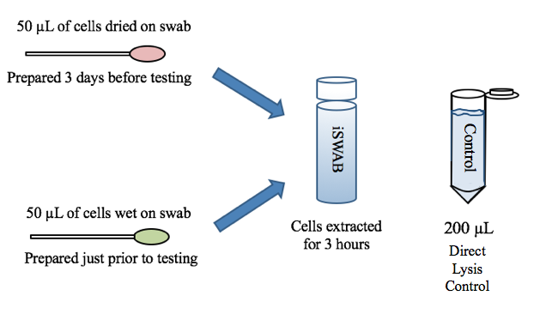
Test DNA Recovery: Wet and Dry Swabs
Notes:
9

Slide 10
Result: No Significant Difference in DNA Recovery
 | Overall Average of DNA Concentration (ng/uL) | Overall Standard Deviation
Dry | 1.54 | +/- 0.29
Wet | 1.63 | +/- 0.03
Direct Lysis Control | 1.77 | +/- 0.04
50µL of cells directly in iSWABTM buffer | 1.78 | +/- 0.05
Notes:
10

Slide 11
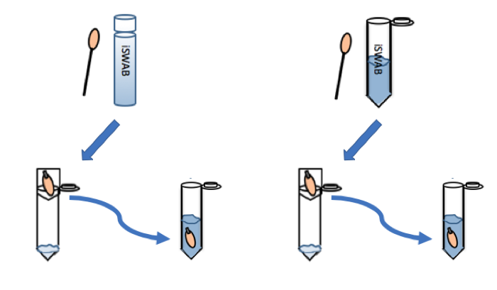
Test Efficiency of the Prong Mechanism
No Prong Mechanism
Prong Mechanism
Initial
Initial
Swab after elution
Swab after elution
Eluted
Eluted
Notes:
11

Slide 12
Results: Prong Mechanism Significantly Increase DNA Recovery
Average % of Total ng of DNA
1.0
12.0
78.6
Notes:
12

Slide 13
Test Recovery from Dried Body Fluid Stains
Body Fluids | Combinations
Blood Semen Saliva | Cotton Swab moistened with iSWABTM buffer | Nylon Flocked Swab moistened with iSWABTM buffer
 | Cotton Swab moistened with dH₂O | Nylon Flocked Swab moistened with dH₂O
Notes:
uL of each body fluid
100 uL used to moisten the swab
I had 3 body fluids of interest that were dried and collected using 4 combinations of swab type and moistening solution
An additional study was designed that incorporated semen and whole blood, along with another type of swab—the classic cotton swab. The objective of this study was to determine the most effective method of collection for dried body fluid stains. 50 uL of each body fluid were pipetted onto petri dishes and let dry for a couple of days. Cotton and Nylon swabs were used to collect the dried stains using either MAWI Buffer or deionized water. A standardized swabbing technique was employed to ensure that all swab stain combinations were treated equally.
All swabs of samples were left in iSWABTM-ID collection devices for approximately 3 days to extract, due to prior information that sperm cells would lyse in iSWABTM buffer if left for a longer extraction period. Controls were made by directly pipetting the body fluids onto the different types of swabs.
13

Slide 14
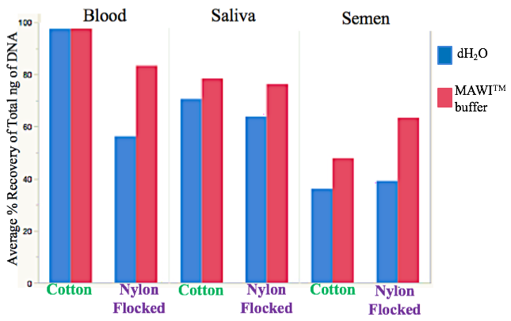
Results: Recovery from Dried Body Fluid Stains
Notes:
14

Slide 15
Comparison of DNA Recovery Using iSWABTM Buffer and Silica Based Extraction
Sample | Total DNA (ng) | Average Total DNA (ng)
iSWABTM Buffer Extract | 621 | 552 ± 62
 | 501
 | 534
Silica Based Extract | 129 | 162 ± 40
 | 150
 | 207
Notes:
15

Slide 16
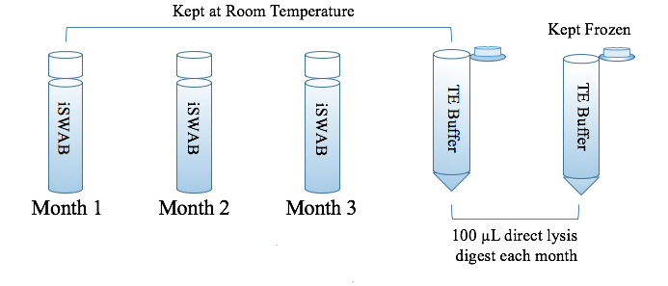
Stability of DNA in iSWABTM Buffer Over 3-Month Period
Notes:
16

Slide 17
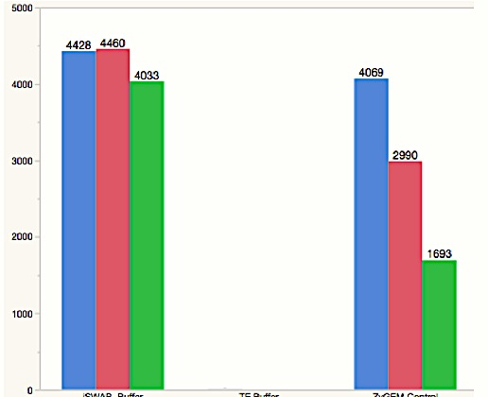
Results: Stability of DNA in iSWABTM Buffer Over 3-Month Period
Average Total ng of DNA
Month 1
Month 2
Month 3
No DNA
iSWABTM buffer
Room Temperature
TE buffer
Frozen
TE buffer
Notes:
17

Slide 18
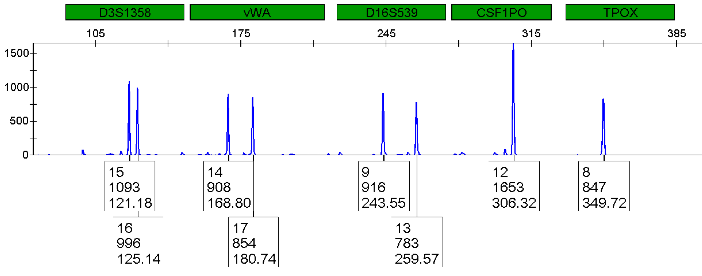
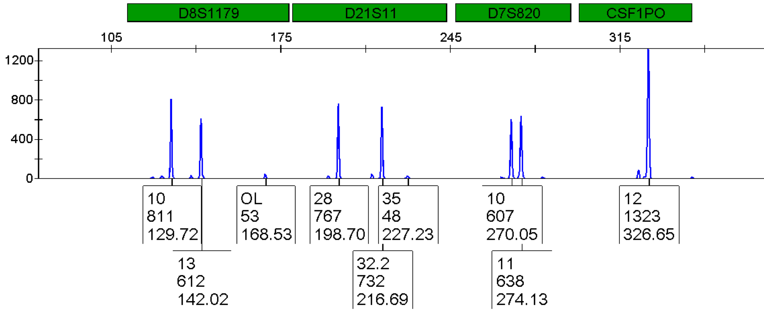
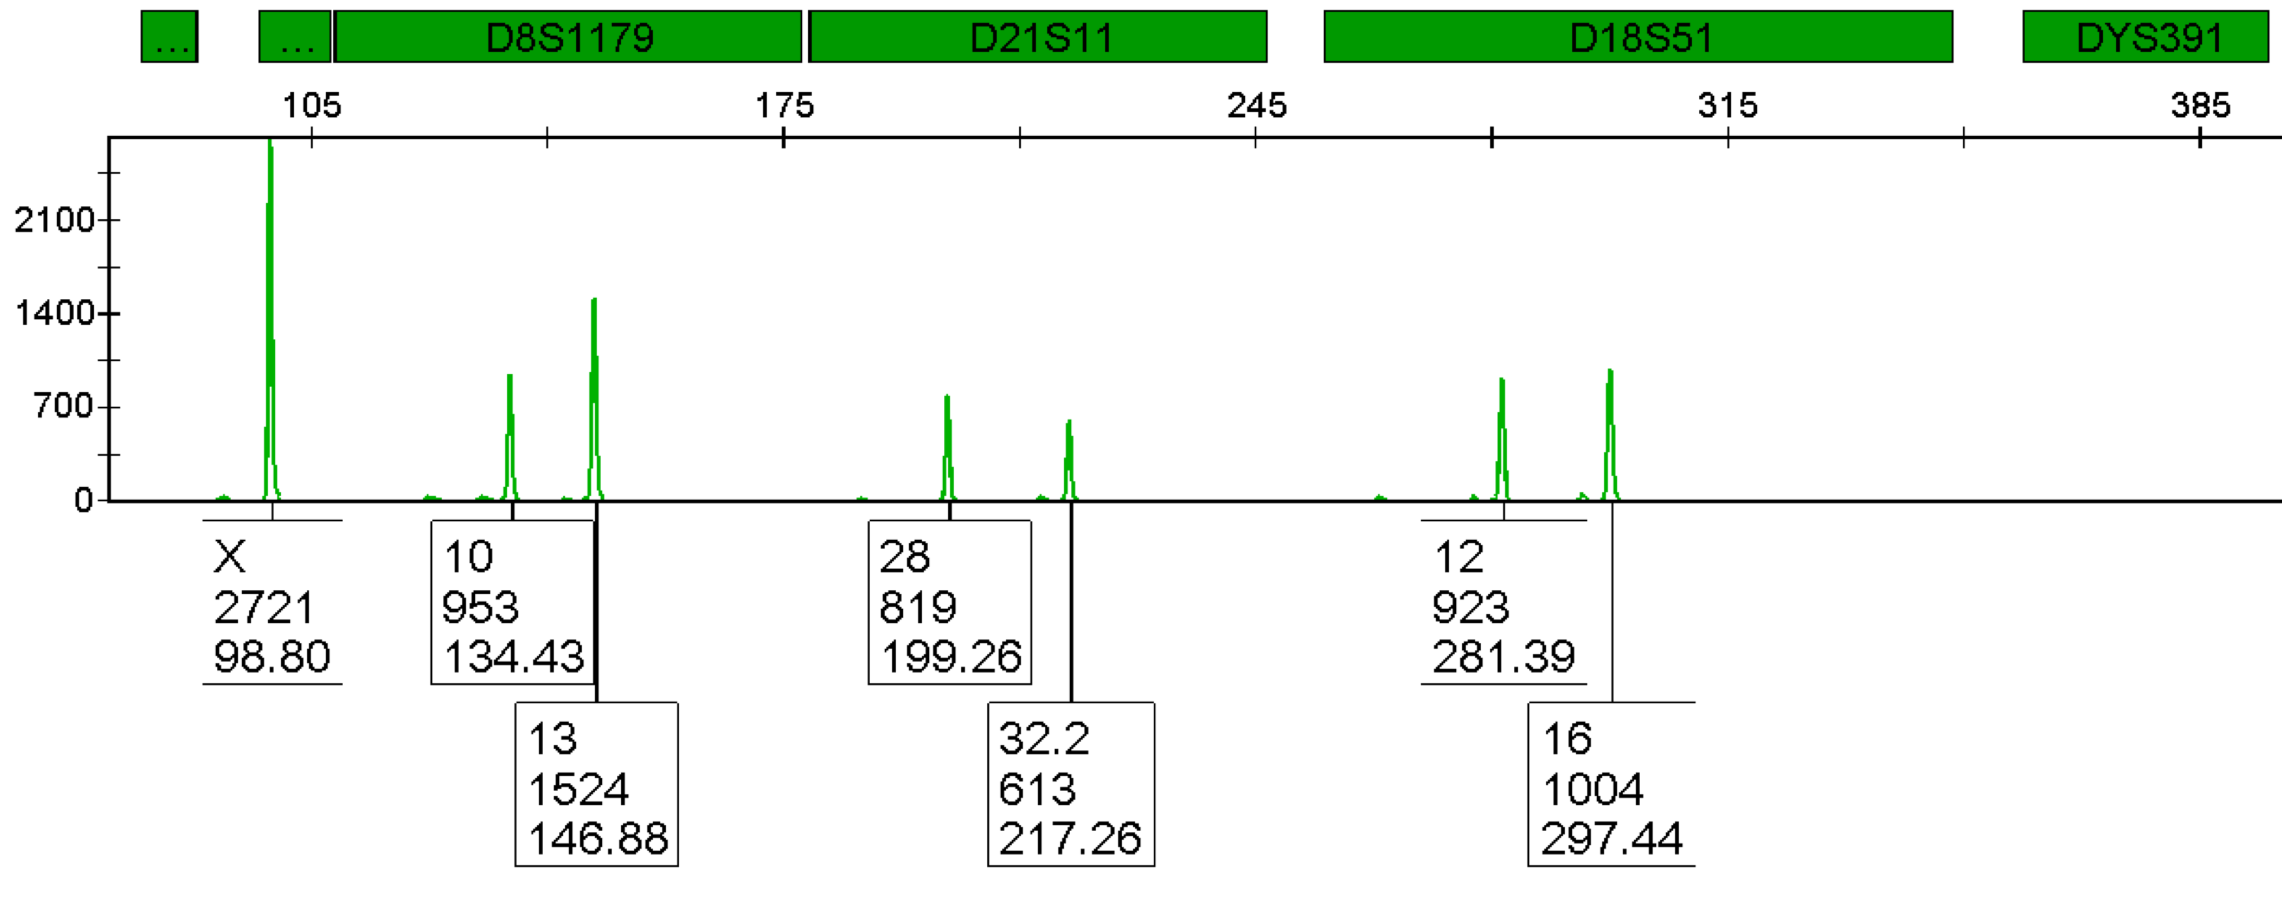
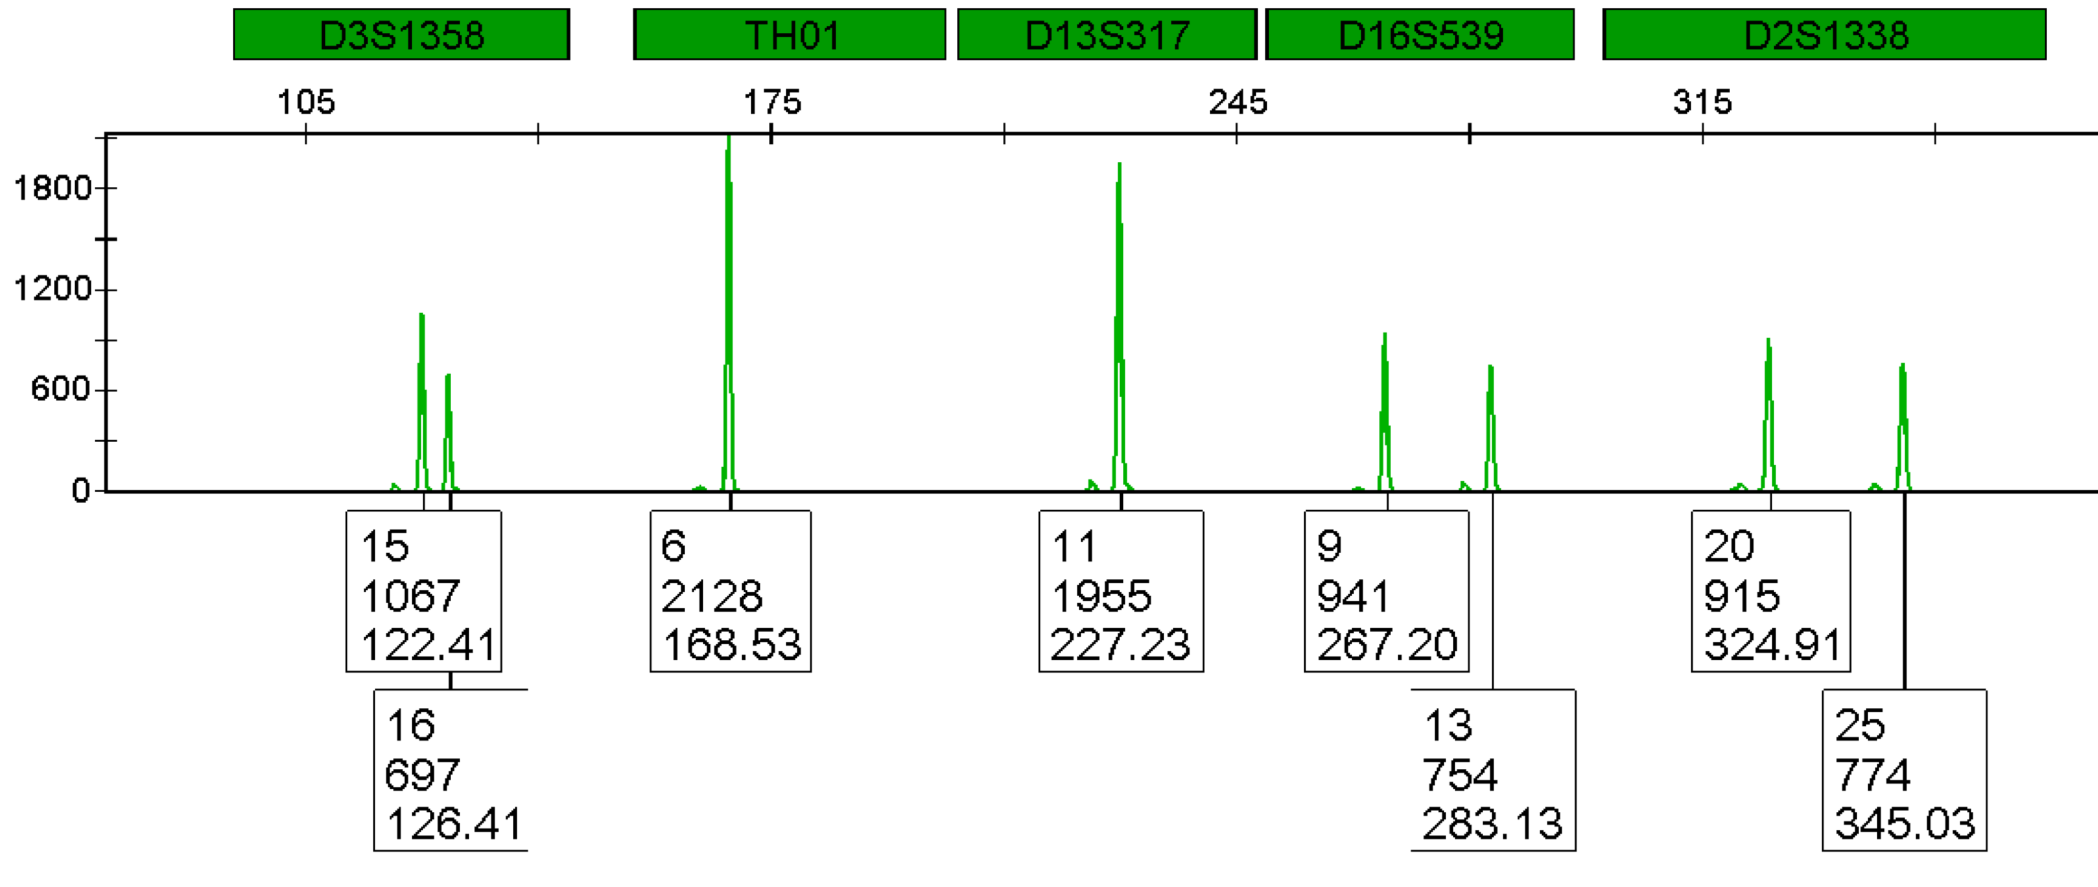
STR Profiles: 3 Months in iSWABTM Buffer at Room Temperature
GlobalFiler®
Identifiler® Plus
Notes:
18

Slide 19
Conclusions
Use of the iSWABTM buffer enhances dried stain collection
Swabs can be processed immediately or after being dried
Mechanics of the device significantly enhance the recovery of cells from the swab
Can lyse sperm, WBC and saliva cells
Recovers >2 times more DNA than Silica Based Extractions
Must dilute to a concentration of 0.2X or lower prior to PCR (experimental data used 0.1X)
PCR Amplification of 0.1X iSWABTM buffer produces full, high quality profiles
Demonstrated DNA stability for up to 3 months at room temperature
Notes:
19

Slide 20
Acknowledgements
Dr. Robin Cotton, Thesis Advisor
Dr. Bassam El-Fahmawi from Mawi DNA Technologies
Biomedical Forensic Science Program
Notes:
20

Slide 21
QUESTIONS?
gordonmk@bu.edu
Notes:
21

